Slide 1

Introduction to Graph neural networks (GNNs)
School of Electrical Engineering and Computer Science
Ajay Krishna, Ali Raza, Irené Tematelewo, Rajesh Mangannavar
{krishnaj, razaa, temateli, mangannr}@oregonstate.edu
School of Electrical Engineering and Computer Science
Oregon State University
Notes:
A short teaching module for GNNs.

Slide 2
Contents
Introduction and motivation
Representation
Components of GNN
Training GNNs
Expressive power of GNNs
GNN applications
Chemistry
Vision
Task and motion planning
Anomaly detection
Limitations
Frameworks to get started

Slide 3
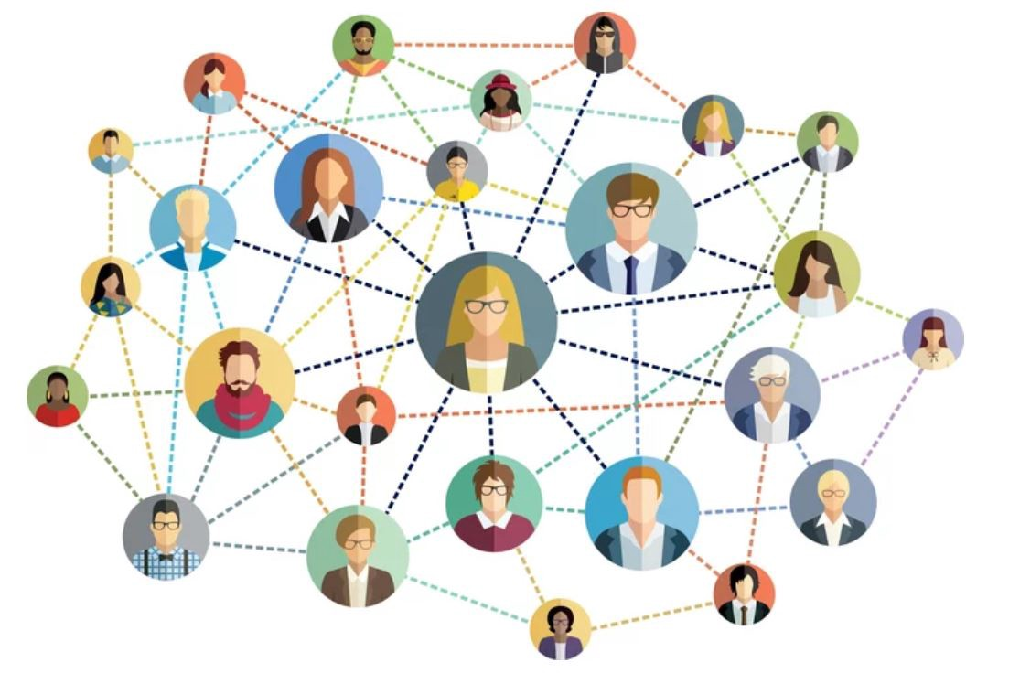
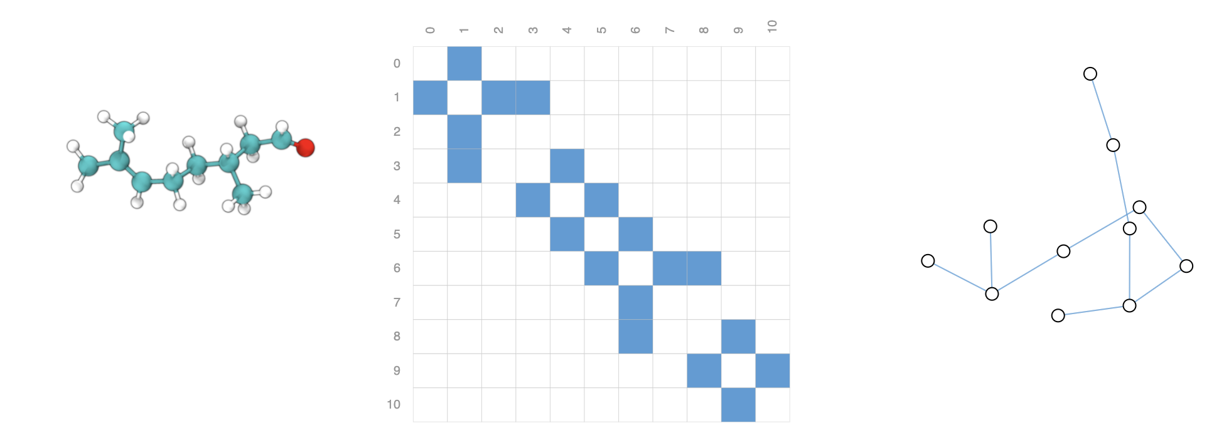
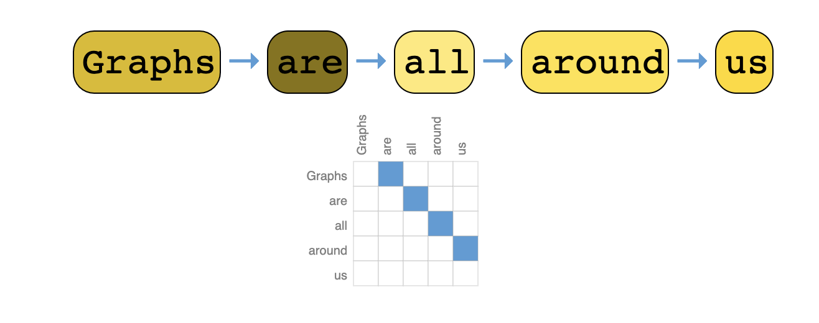
Why Graphs
Social network as graph
Textual data as graph
Molecule as a graph
Notes:
Graphs are all around us. Real world data is often defined in terms of their connections to other things.
There are many problems which are naturally easier to be expressed as graphs – such as social networks, molecules etc.
Hence it is useful to build machine learning models for this kind of data
For molecules we want to make predictions at graph level for drug discovery etc.

Slide 4
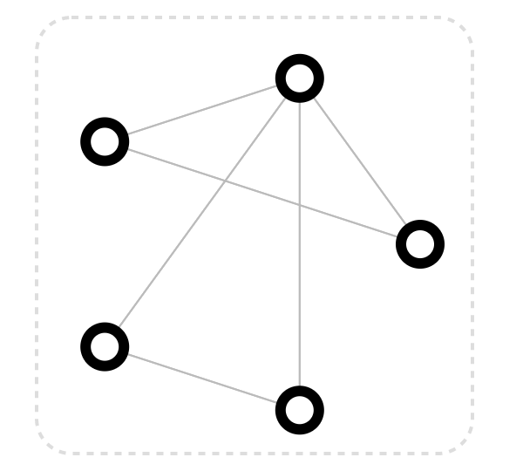
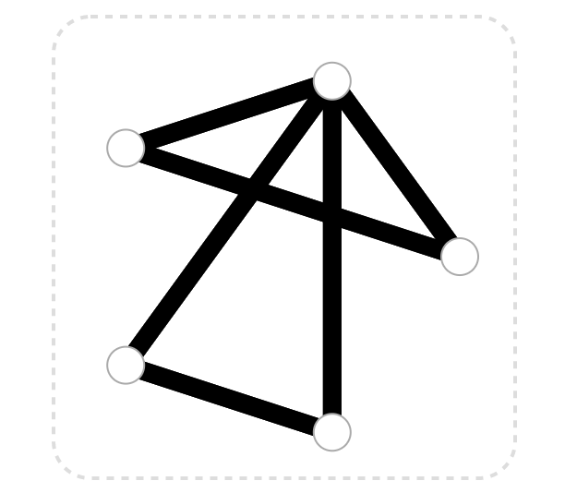
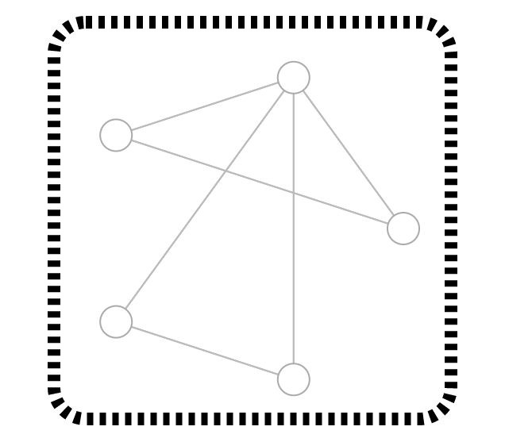
Graphs and Their components
Nodes¹
Edges¹
Full graph – collection of nodes and edges¹
Notes:
Each graph is made up of Nodes and edges. Edges represent the relation between the nodes and nodes generally correspond to some entity in the world

Slide 5
Real World Examples of Graph Data
Representation of a molecule – adjacency matrix and a graph represenation¹
Notes:
More Examples of graphs in real world and their representations as adjacency matrices

Slide 6
Real World Examples of Graph Data
Representation of textual data adjacency matrix¹
Notes:
More Examples of graphs in real world and their representations as adjacency matrices

Slide 7
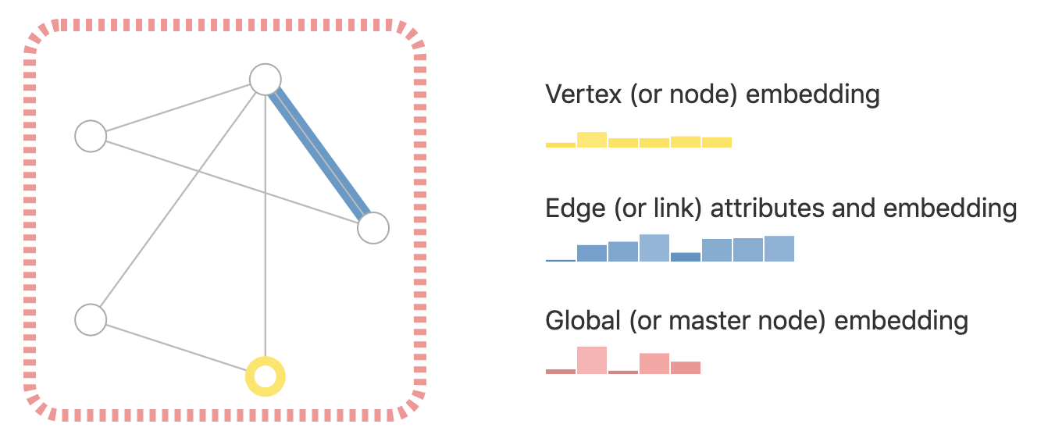
Information Stored in Graphs
Types of information Graph stored in graph components¹
Notes:
At each components (node, edge or global), we can store information about corresponding to that component – it can be represented as a feature vector .

Slide 8
Types of Predictions on Graph Data
Graph level predictions - predicting a property of the entire graph
Node level Predictions - Classifying each of the nodes
Edge predictions - predicting the existence of edges (start with fully connected and prune)
Generate graphs that are similar to the training set or that optimize a given objective/constraint

Slide 9
Challenges of Using Graph Data in Machine Learning
Using adjacency graph not trivial – memory constraints
Adjacency matrices not permutation invariant – the ordering of the nodes changes the matrix
Adjacency lists are both memory efficient and permutation invariant.
Notes:
The nodes, edges etc. and their properties can be represented as a matrix.
Representing a graph’s connectivity, even as an adjacency matrix and using it as an input is a non-trivial task as we can have millions of nodes and it becomes very meory inefficient
Adjacency matrices are also not permutation invariant – the ordering of the nodes changes the matrix for the same graph.
Adjacency lists are both memory efficient and permutation invariant.

Slide 10
Graph neural networks
1. Neural networks developed to operate on graph data
2. Recent advancements have improved the capabilities
3. Practical applications is a wide range of domains (chemisty, vision etc.)
Notes:
Graph neural networks are neural netowrks developed to operate on graph data.
There have been numerous advancements in recent times that have increased the capabilties of GNNs – they have more expressive power, can handle larger graphs and are applicable in a wide range of domains.
Hence, Studying graph neural network

Slide 11
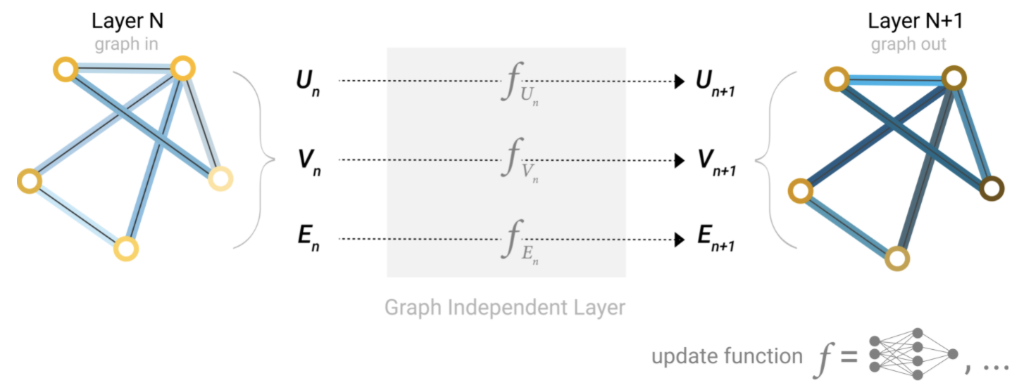
A Simple GNN
A simple graph and application of 1 GNN layer¹
Input graph with ndoes, edges and global embeddings
Single Layer¹:
Update functions – modify each component (Each update function can be a different NN)
Generate new graph with same components with different embeddings
Notes:
The input is a graph with features for nodes, edges and global features.
A single layer of a GNN consists of
An update function f exists for each type of information – for node, edge and global information.
It could be an MLP or any other model.
Here, the update functions is applied to the respective embeddings and to produce a new graph - and this is one layer of a graph neural network.

Slide 12
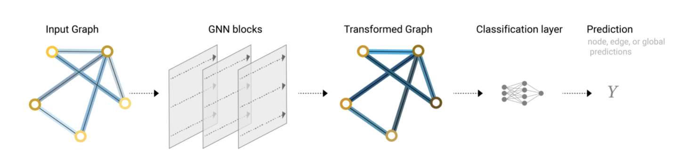
A Simple GNN
Stacking multiple layers¹
Multiple of these layers¹ can be stacked.
Update functions only modify embeddings, not graph structure
Notes:
Since the update functions are not updating the connectivity of the graph, the output graph is represented the way the input graph is - only the value of the embeddings has been updated.
This is a basic GNN which does not use the connectivity information in the graph

Slide 13
Stacking Layers
Stacking layers in GNN¹
Each layer can have same or have different update functions
Predictions are made after all layers have been applied
Notes:
Here we see that multiple layers of the GNN can be stacked.
In this case, each layer updates the node representation.
After all the layers have finished processing, can be done and then the prediction is made for the required task on any graph component.

Slide 14
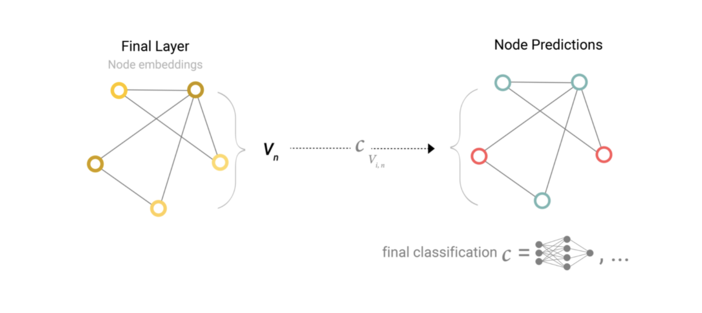
GNN Predictions
Graph Prediction using a model¹
Use any Neural network architecture to make predictions after applying multiple layers of GNN
Can be done at node level, edge level or graph level
Notes:
Now we have a way to update the information in the graph (by applying ). Next step is to use the updated graph to make predictions.
Suppose we are doing node classification, we just have to apply a classifier on all the nodes.

Slide 15
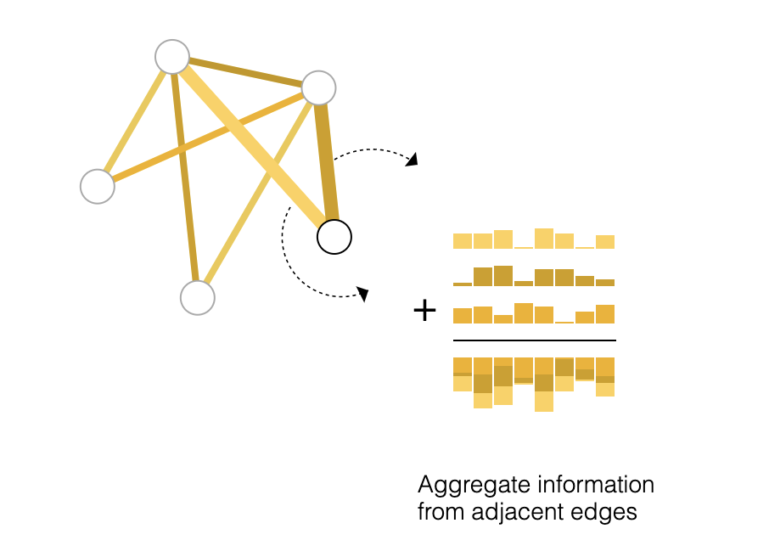
Pooling Information
Pooling information from neighbours¹
Utilize the connections in the graph
Gather information from neighbours
Aggregate (Ex: From edges to nodes – P_{En}->P_{Vn})
Notes:
Now, we want to utilize the power of connections in the graph.
So, for each node, we can gather information from the neighboring edges.
This information is aggregated - the edges and that particular node’s information and then passed to the update function.
The aggregation from edges to node is P_En->P_Vn

Slide 16
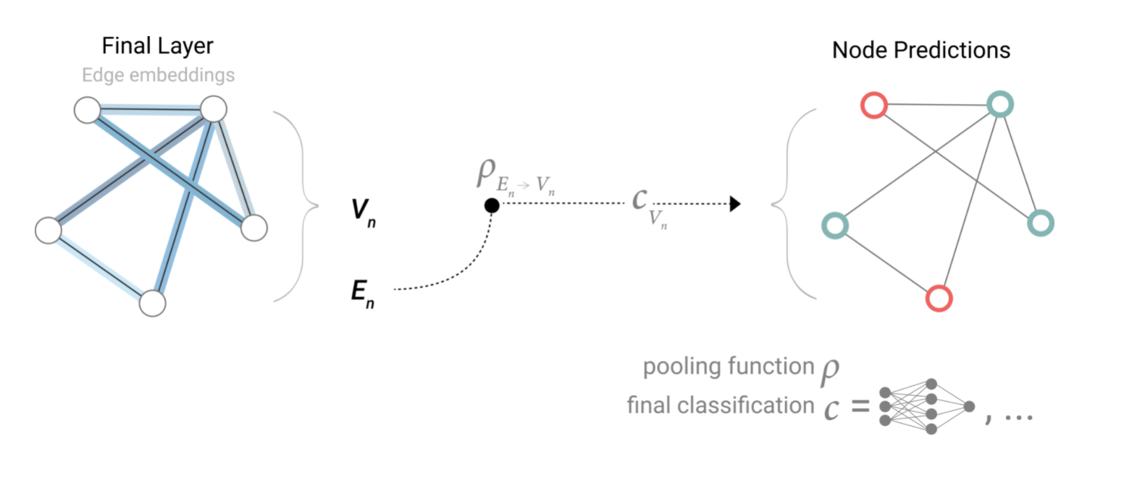
GNN Predictions with Pooling (readout)
Graph Prediction on aggregated information¹
Pool information from neighbours and aggregate
Apply a network on this aggregated information
Notes:
Here, each node is updated by the pooling of information from the neighboring edges and the classifier is used to make a prediction on each node.

Slide 17
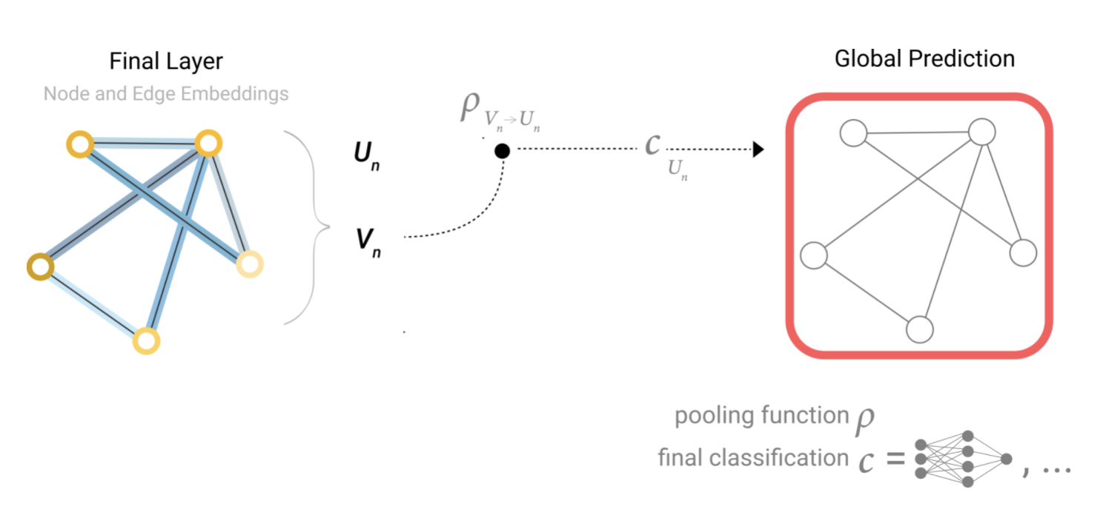
GNN Predictions with Pooling
Graph Prediction using a model¹
Graph level Predictions can be on
Global features
Aggregated information
Notes:
We can also make predictions on the global features as well as aggregate all node information into global features.

Slide 18
Aggregation
Process of
Pooling all the information (node/edge/global embeddings)
Combining the information meaningfully
Should be applicable in case of variable size as well
Notes:
Aggregation is the process of collecting information from all the neighbours
Then the information of the neighbours and the entity itself which is receiving this messages are combined to create a new embedding for the entity
Then this updated information can then be used as input to the update function or for further aggregation

Slide 19
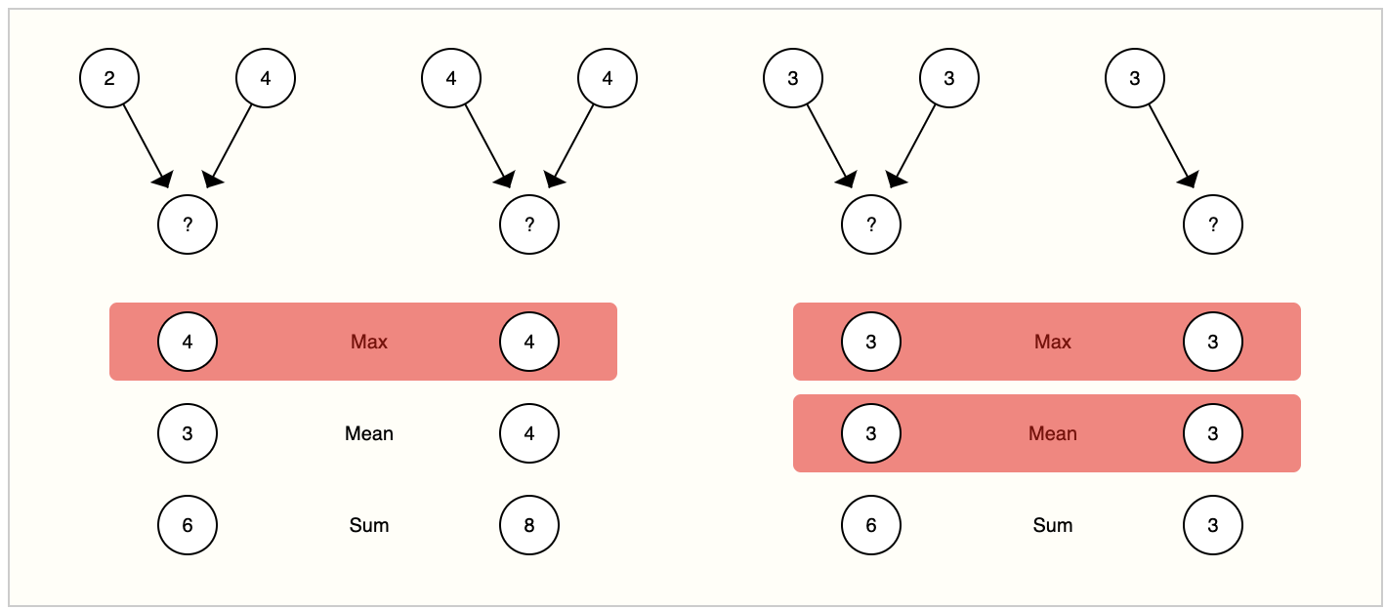
Aggregation functions
Aggregation function for different graphs¹
Some common aggregation functions
Sum (add)
Max
Mean
Notes:
Some of the common aggregation functions are sum,max and mean. They all aggregate information differently and have different expressive power. The different expressive power of these aggregation functions will be discussed in the coming slides. But the thing to note is that no aggregation function can differeentiate between all graph pairs

Slide 20
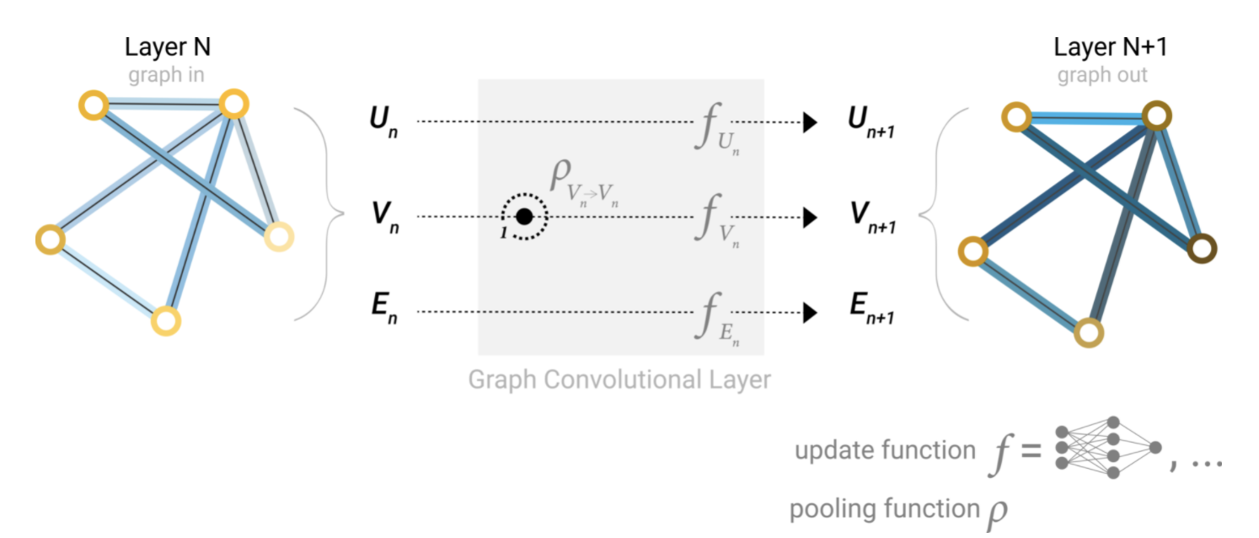
Aggregation
Example of message passing between nodes¹
Aggregation similar to convolution in images – information from neighbouring nodes/pixel is aggregated
Notes:
This is an example of information pooling from nodes to nodes (a node takes information from its neighboring nodes).
This aggregation can also be seen similarly to convolution in images - information from neighboring pixels/nodes is aggregated together.

Slide 21
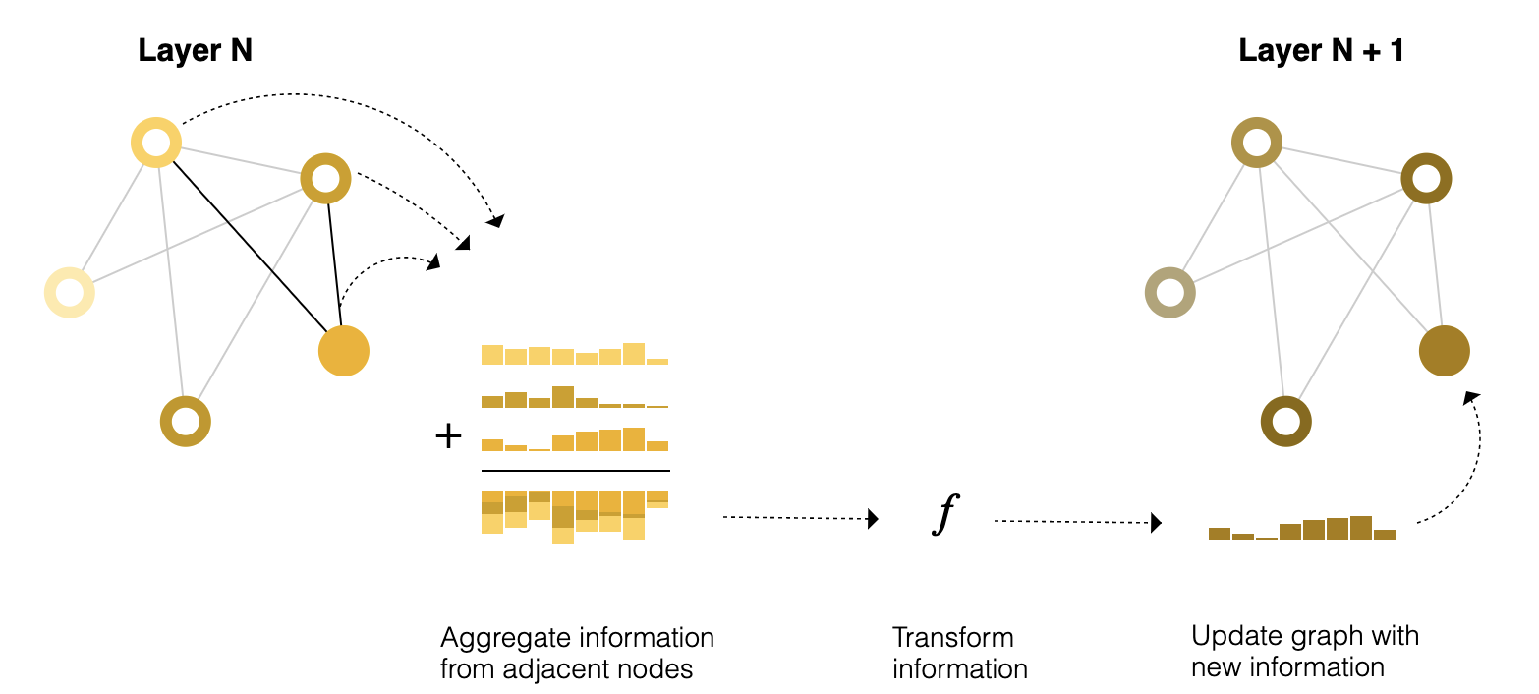
Message Passing
Message passing in GNN¹
Pooling can be done at any stage
At the end before predictions
At every layer
Notes:
Until now, we have talked about updating the embedding, pooling this final values of the embedding and making predictions.
Pooling can also be done at each GNN layer and is also known as message passing.

Slide 22
Message Passing
Message passing in GNN¹
Message Passing
Pooling
Aggregation
Notes:
In message passing process, first the pooling of information is done - for each node, we can pool embedding information(messages) from other nodes.
All the information is then aggregated (ex: sum). There are multiple aggregation functions and we will talk about it in a separate section
This aggregated information is now passed through a update function.

Slide 23
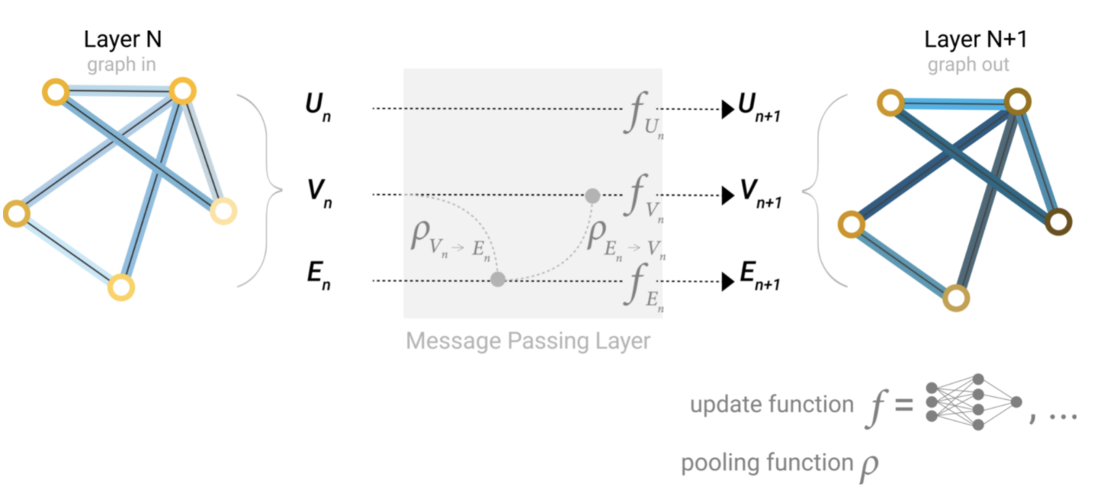
Message Passing
Example of message passing between from nodes to edges¹
Aggregation can be between any kind of entities
Edges, nodes and global can all send information between each other
Notes:
In this example, the information of nodes is being aggregated to update the information of an edge.
This updated edge information is then aggregated at each node.

Slide 24
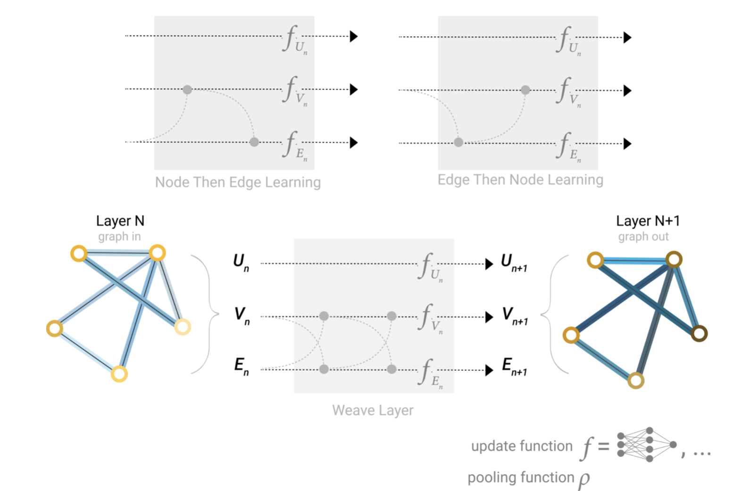
Message Passing
Example of message passing between from nodes to edges and vice versa¹
Message passing can be done more than once at a single layer
There are multiple ways of doing aggregation
Best option depends on the application
Notes:
The message passing in a single layer can be done in multiple ways. It can happen between nodes and edges and vice versa, and it can also happening multiple times in a single layer
The aggregation can also be done in multiple ways – it can be different for nodes and different for edges, and so on
The ideal choice of ordering is still an active area of research.

Slide 25
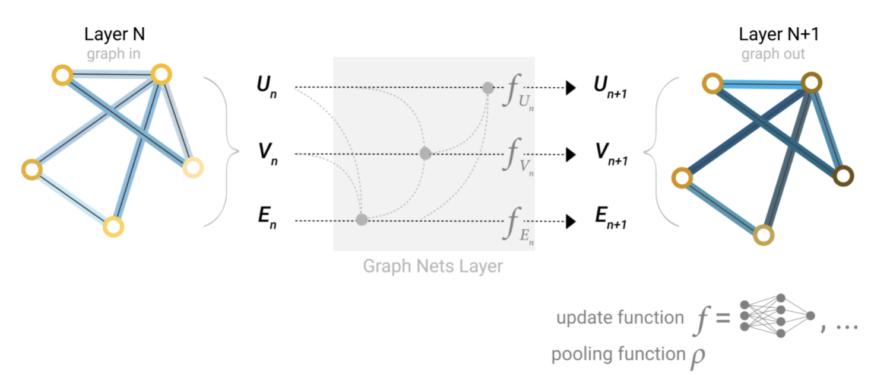
Message Passing
Example of message passing between nodes,edges and globals¹
Messages can be passed between global information and other entities as well
Useful when trying to move information between far off entities
Notes:
Message passing can also happen between global attributes and other components of the graph.
This is especially useful when we want to connect nodes which are far apart from each other - one way is to run message passing multiple times, but that might not be enough.

Slide 26
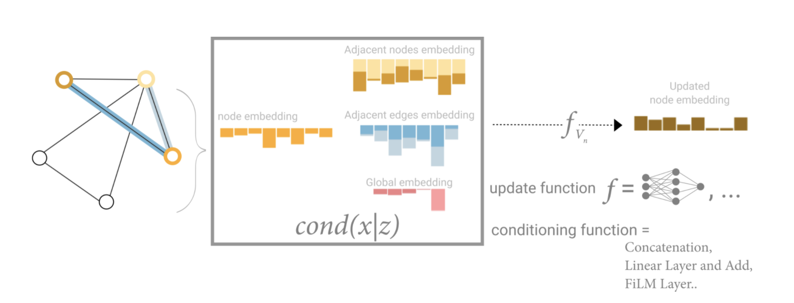
Message Passing
Information available for message passing¹
Edges, nodes and global can all send information between each other
How and what information to use is task dependent
Notes:
Overall, we can use information from nodes, edges, global representations to update node information (also edge and global).
Selecting which information to use for message passing is a design choice based on the task.
We can also use different aggregation functions in different layers or between different entities based on the application and use case

Slide 27
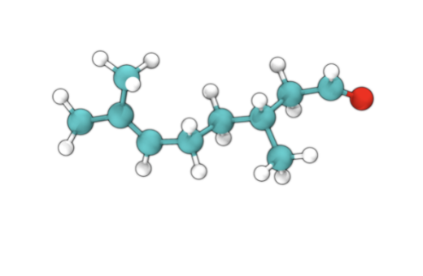
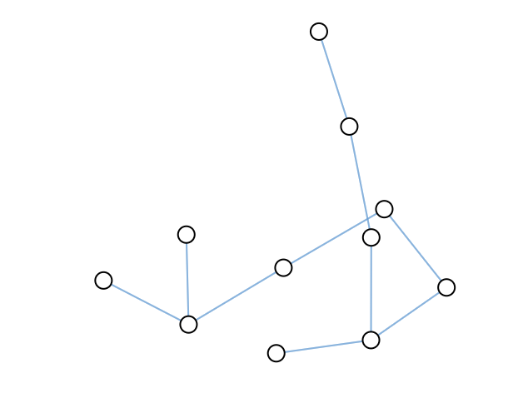
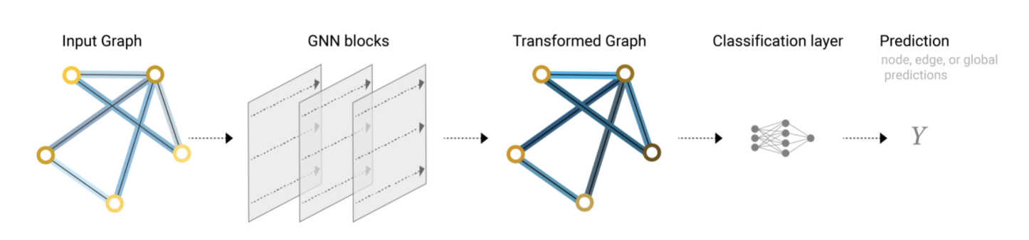
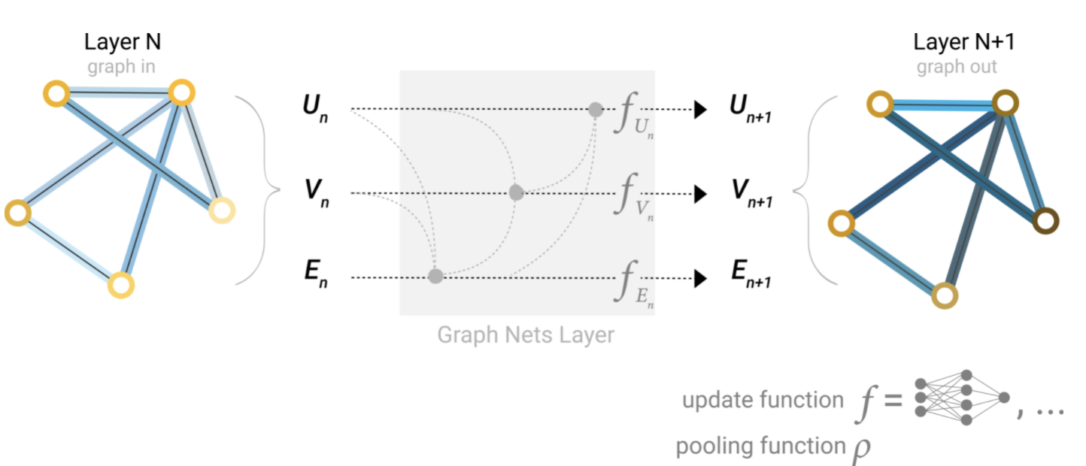
Putting it all together
Create graph from input
For each layer in GNN
Aggregate information from neighbours
Apply update function
Apply final network to extract results
Notes:
Here we just see the whole process in one go.
We start with data, convert it to a graph with features.
Then we apply the multiple layers of the GNN where each layer does message passing and update
Then after all the layers have been applied, we use a different network to make predictions

Slide 28
Effect of different components on GNN​
To show the effect each component of GNN has on the results we obtain, we will show the effect of different parameter choices for each of the components and walk through how they affect the results​
​
The task for which the results are being compared are for the cora dataset available as part of the pytorch geometric library¹

Slide 29
Experiment details
Dataset : Cora dataset¹
A citation network among papers.
The Cora consists of 2708 scientific publications with links between each other representing the citation of one paper by another.
The task is to classify each publication into one of seven classes.
Notes:
A citation network among papers.
The Cora consists of 2708 scientific publications with links between each other representing the citation of one paper by another.
The task is to classify each publication into one of seven classes.

Slide 30
Example Problem and Graph Structure​
The dataset in is represented as a graph
Papers are the nodes
The edges represent the citation link
Notes:
Each publication is represented by a bag-of-words vector. This implies that we have a vector of 1433 elements for each publication, where a 1 at feature i indicates that the i-th word of a pre-defined dictionary is in the article.
Binary bag-of-words representations are commonly used when we need very simple encodings.

Slide 31
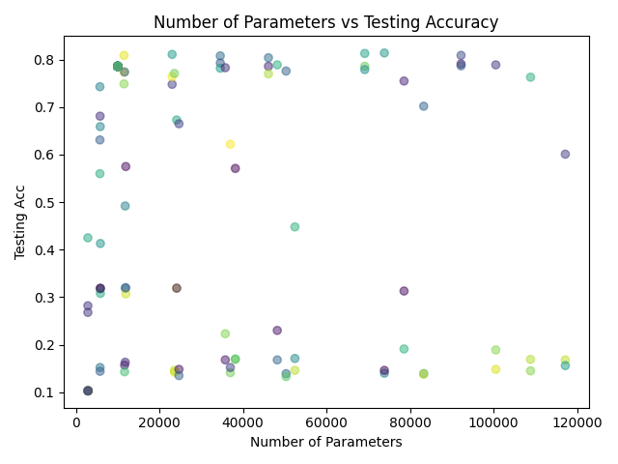
Number of parameters vs Performance​
Comparison between number of parameters and performace¹
No direct relation – need to look in deeper
Notes:
Here we can see that increasing the number of parameters (either by increasing the number of GNN layers or higher feature dimensions etc.), the performance does improve. (Each dot represents a different model with different choice of parameters , so 2 models may have the number of parameters but have very different performance based on the how the parameters are being used – by adding more layers or by having a higher dimensional feature representation etc.)
But it is also evident that just increasing the parameters doesn’t always increase the performance (large number of points have low performance with high parameters)
Hence, it matters how and what parameters we are modifying in our network which affects the results
From next slide, we will go into how different kinds of parameter changes affect the performance

Slide 32
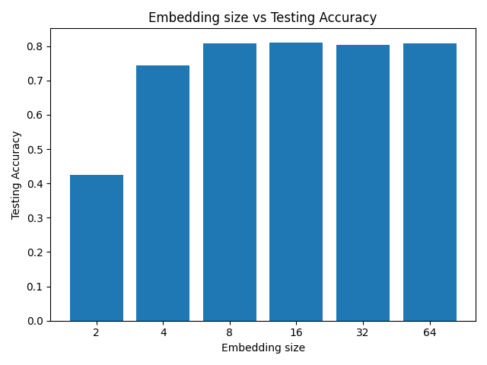
Embedding dimensions vs performance​
Comparison between embedding dimensions and performace¹
Higher dimensions are useful upto a certain point for the given task
Notes:
The first hyperparameter we look at is the feature dimensions – of nodes, edges and global features
We can see from the graph that increasing the feature size from 2 to 10 generally increases the mean performance but does not help too much when increased to 32 or 64.
This implies that the size 8 is enough for capturing the information and increasing beyond that doesn’t yield the same benefit as going from 2 to 8

Slide 33
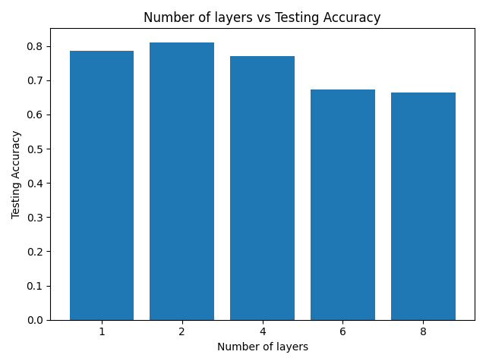
Number of layers vs performance​
Comparison between number of layers and performace¹
Higher number of layers do provide better performance
Notes:
The next hyperparameter we look at is the number of layers in the graph neural network.
We can see from the graph that increasing the number of layers from 1 to 2 increases the mean performance but decreases it further – this is due to the model overfitting when there are too many layers

Slide 34
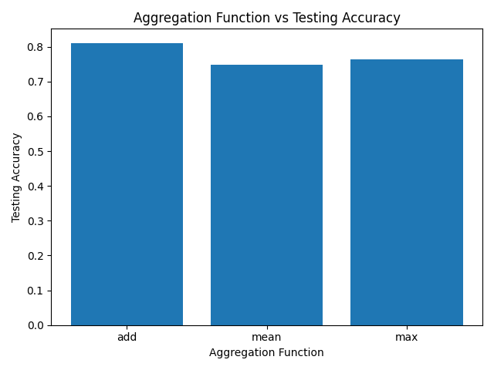
Type of aggregation vs performance​
Comparison between different aggregation function and performace¹
Add Aggregation function is the best here
Notes:
The next hyperparameter we look at is the type of aggregation – we have multiple choices and here we see the difference between 3 of them.
We can see from the graph that Add has an advantage over the other methods. One point to remember here is that this is only for the given problem at hand and it might be different for different problems/datasets

Slide 35
Effect of different components on GNN Summary​
Higher parameters do no guarantee better performance
Feature embedding size helps to a certain extent
Aggregation function effect is task dependent
Overall, majority of the design choices still very problem specific – no clear winners yet
Notes:
For the given problem, we see the following trends :
Higher parameters does not necessarily mean better performance, it's how the parameters are used as part of the GNN structure that are more important
Increasing dimensions of the feature vectors representing the nodes, edges etc. is helps to a certain extent and doesn't improve performance beyond a certain point
The choice of the aggregation function did not affect the performance too much in this case but as we will see in the case of a different problem (under GNNs for chemistry), the choice of the aggregation function will make a big difference
Overall, the choice of the hyperparameters and the design of the network and what works best is very problem specific. But we can say that higher message passing helps improve performance so if the entities and relations in the graph are chosen well, GNNs are a good way to process and learn from that graph representation

Slide 36
Training of GNNs

Slide 37
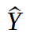
GNNs training
Prediction layer
Trainable components
Notes:
How are GNNs trained?
Given a prediction task using a GNN architecture like current one, the components of the network that trainable are the embedding blocks and the prediction layer highlighted in green.

Slide 38
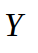
GNNs training
Prediction layer
Evaluation Metrics
Loss
Trainable components
Ground truth
Notes:
The training process is similar to that of regular neural networks trained via gradient descent to minimize some loss function.
Depending on whether the task is a regression or a classification, the loss function can either be the mean squared error (MSE), the cross entropy (CE) loss or any other loss function.
We define the mean squared error (MSE) and the cross entropy (CE) loss in the next slide since they are the most commonly used losses in machine learning

Slide 39
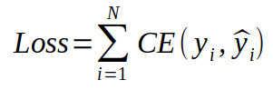
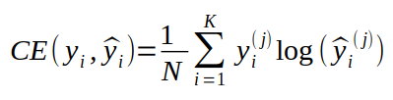
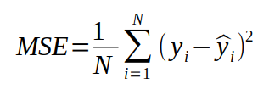
GNNs training
Loss function
Classification tasks (k classes): the target variable is discrete (e.g: the class of a given input image)
where
Regression tasks: the target variable is continuous (e.g: the level of toxicity of a molecule)

Slide 40
GNNs training
Prediction layer
Evaluation Metrics
Loss
Backpropagation
Ground truth
Notes:
Once the error between model prediction on the true value are calculated using a loss function such as those introduced in the previous slide, the network can be trained by:
- computing the gradient of the loss w.r.t the parameters via backpropagation,
- updating the parameters via stochastic gradient descent.

Slide 41
GNNs in chemistry

Slide 42
GNNs in Chemistry
Molecules are naturally represented as Graph
Atoms are vertices
Bonds are edges
Notes:
As we mentioned earlier, some data can be naturally represented as graphs. Chemical compounds are perfect example of this. Atoms can be represented as nodes and bonds can be represented as edges.

Slide 43
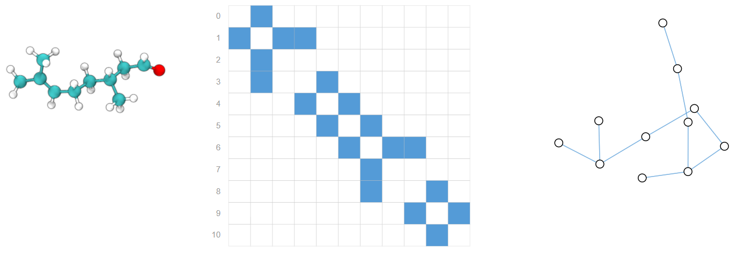
GNNs in chemistry
Citronellal molecule (Center) Adjacency matrix of the bonds in the molecule (Right) Graph representation of the molecule.¹
Notes:
Example of molecule represented as graph

Slide 44
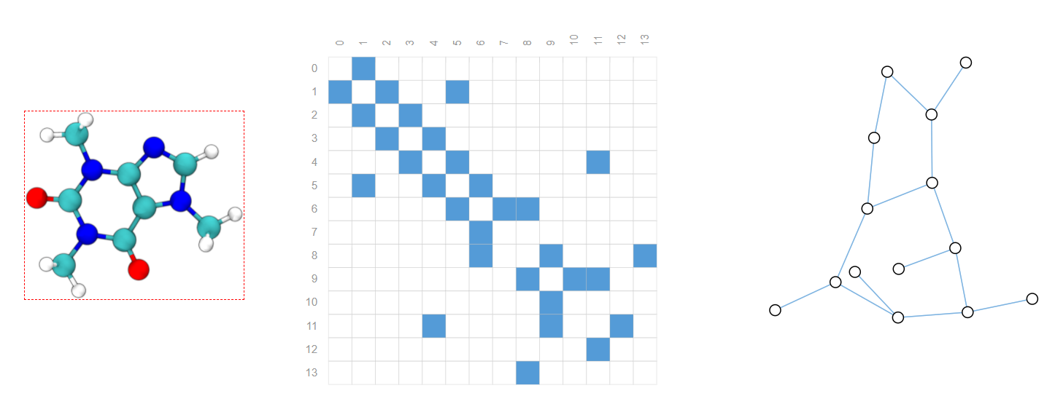
GNNs in chemistry
3d representation of the Caffeine molecule (Center) Adjacency matrix of the bonds in the molecule (Right) Graph representation of the molecule.¹
Notes:
Another example of molecule as a graph.

Slide 45
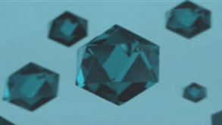
Motivation
1
Metal Organic Framework (MOFs)
Nano-porous materials
Repeated structure (unit cell)
Notes:
Here, we present a more concrete example of when it makes sense to work with graph. Metal organic frameworks are nano-porous materials. They are build through linkers and clusters. They have a building block called unit cell that is repeated multiple times in space to construct the whole structure.

Slide 46
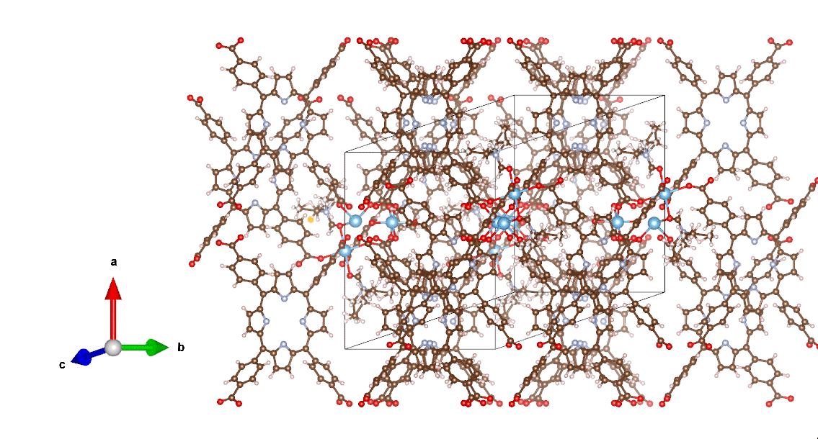
Motivation
metal organic framework (MOFs) | nano-porous materials | repeated unit cell
1
Notes:
MOFs have pores and channels. That help them to adsorb gas.

Slide 47
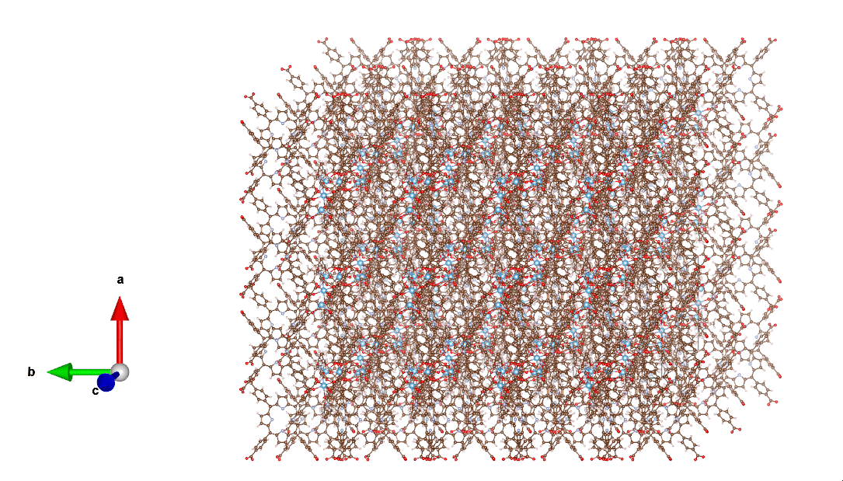
Motivation
metal organic framework (MOFs) | nano-porous materials | repeated unit cell
1
Translational invariance | Rotational invariance
Notes:
The adsorption properties of MOFs depend on the size and the shape of the pores and channels. The objective is to process a unit cell to predict these properties. However, there is no canonical form/view of the unit cell. For example, the cube in the figure above can be placed anywhere in the space and that would be the unit cell.

Slide 48
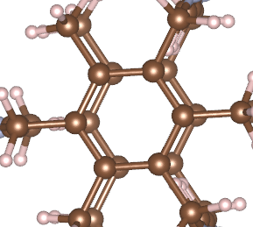
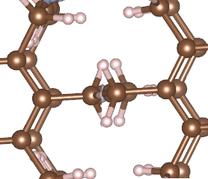
Motivation
A
Metal Organic Framework (MOFs)
Nano-porous materials
Repeated structure (unit cell)
Translational invariance
Rotational invariance
B
Notes:
A and B are the unit cell of the same structure; however they appear significantly different from each other. If we use graphs to represent MOFs, all of these issues can be side stepped. Note that graph of the unit cell will have boundry edges where they will wrap around.

Slide 49
Applications of GNNs in chemistry
Property prediction (drug discovery)
Node level prediction
Charge
Graph level prediction
CO2 adsorption
Molecule generation
Generate graph that are similar to the training set
Generate graphs to optimize for given objective/constraints (valid graphs)
Explainability
Notes:
In chemistry domain, graphs can have node level, edge level, or graph level prediction. GNNs are being used for fast screening of chemical compounds for drug discovery. GNNs can process a large search space of chemical compounds and identify promising candidates. Experimental synthesis (a long and expensive process) can then identify the final compounds. Research are also trying to generate new graphs with desirable properties. The biggest challenge in the chemistry domain is to generate graph that are chemically valid. Explainabilty is also getting significantly attention. Researchers are interested in identifying the substructures that are important for making predictions.

Slide 50
Features
Node Features:
atom type, 3D coordinates, formal charge, in ring, aromatic, valence
Edge Features:
Bond type, geometric distance
Notes:
Features can be associated with the nodes as well as edges. In some instance, features are also associate with the graph it self and act as global feature vector.

Slide 51
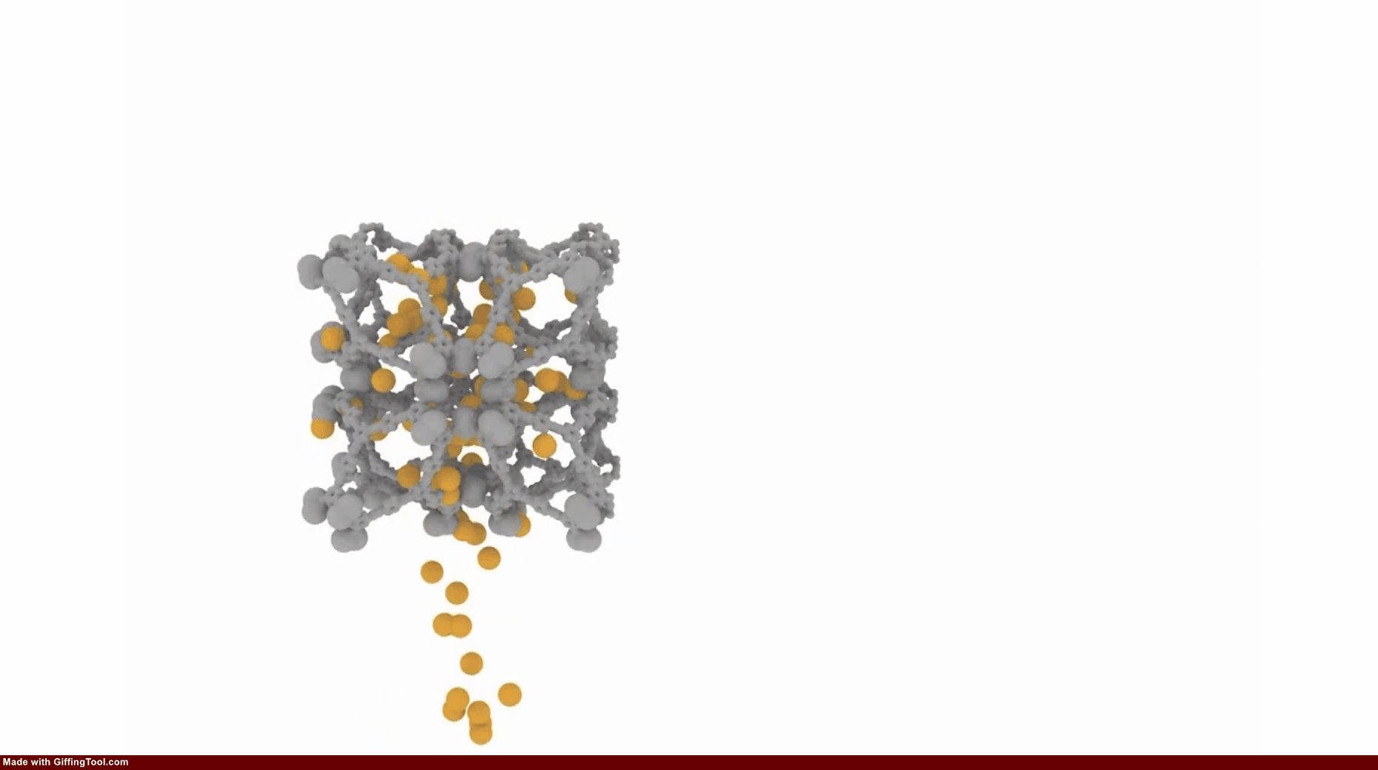
Geometry information in GNNs
1
Notes:
We will talk about an aspect of GNNS in chemistry domain that is different but significantly important. As we mentioned earlier, MOFs are made by linkers and clusters and have pores and channels. These pores and channels allow MOFs to adsorb some gases. For example MOFs are being used to adsorb CO2. When making predictions about these properties GNNs should be able to differentiate Graphs with different shapes.

Slide 52
Geometry information in GNNs
Atoms have 3D position in space
Geometry information is important for molecule in addition to bonding information

Slide 53
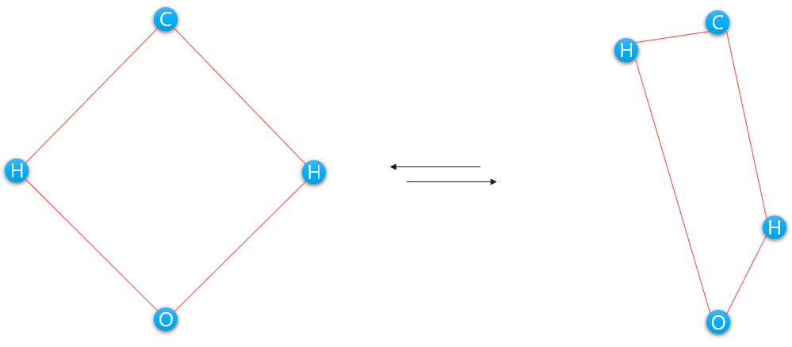
Geometry information in GNNs
molecules with same bonding strucure can have differentgeometry
Notes:
However, normal GNNs will not be able to differentiate between these two graphs. Both of them have the same connectivity information. However, they have different shapes.

Slide 54
Geometry information in GNNs
How to include
Notes:
Hence it is important to include geometry information in GNNS to make more accurate predictions.

Slide 55
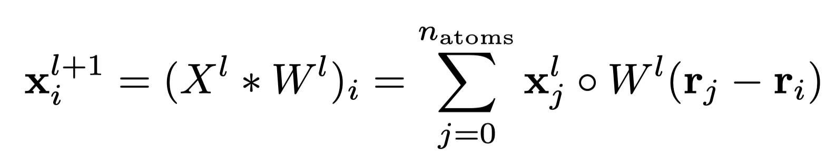
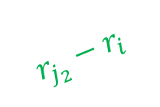
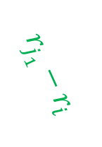
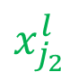
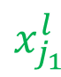
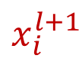
SchNet¹
relative distance
$$x_{j_{1}}^{l}$$
$$r_{j_{2}}−r_{i}$$
C
$$x_{i}^{l+1}$$
H
$$r_{j_{1}}−r_{i}$$
H
$$x_{j_{2}}^{l}$$
O
Notes:
SchNet makes use of geometry information by transforming incoming messages by using distance information. When a node sends a message to its neighboring node, it is transformed by the distance between them. Ideally, SchNet is able to differentiate between any two graphs with different shapes if they have an edges between every pair of nodes and use distance information. However, processing a fully connected graph would be a computational nightmare.

Slide 56
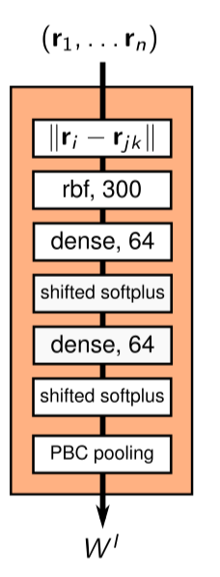
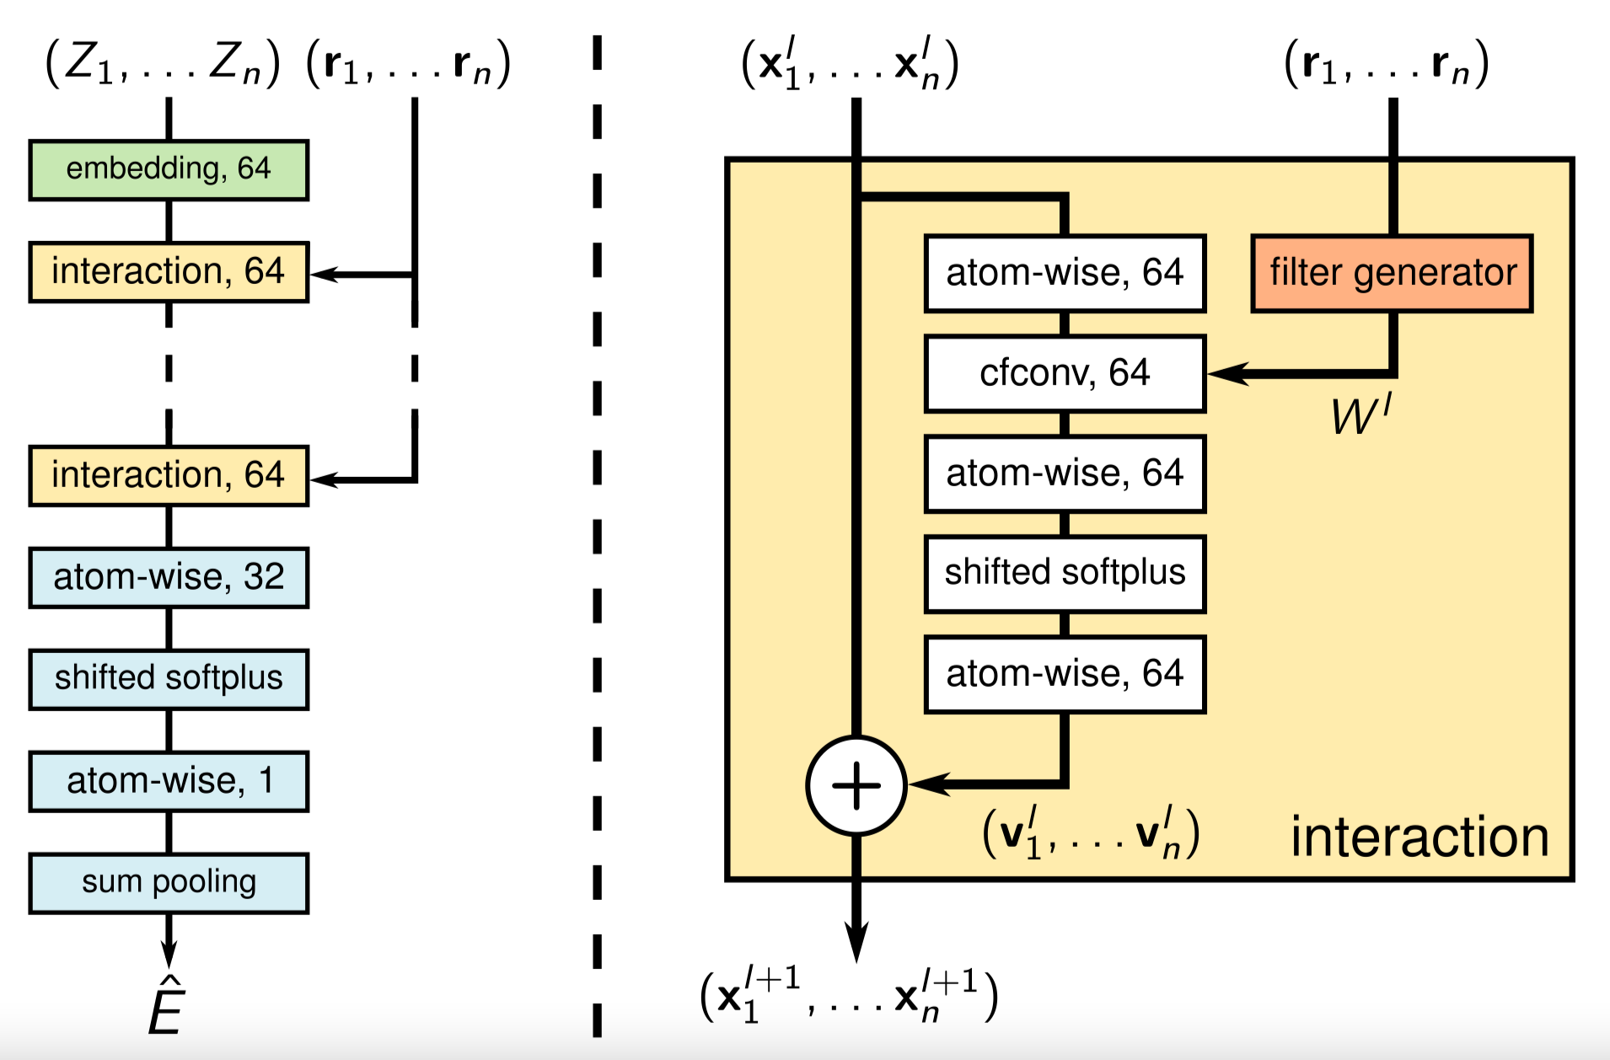
SchNet¹
relative distance
Notes:
Architecture of SchNet

Slide 57

Geometry information in GNNs
molecules with same bonding strucure can have differentgeometry
Notes:
SchNet is cannot differentiate these two graphs. Connectivity information is the same and edge distance are the same. However, since there is no bond(and edge) between H-H or C-O. Graph can change shape without affecting the edge distance.

Slide 58





DimeNet¹
distance between nodes
angle between edges
C
)
$$m_{kj_{1}}^{l}$$
$$α_{kj, ji}$$
$$m_{ji}^{l+1}$$
H
H
O
Notes:
DimeNet proposed a clever idea to incorporate more geometry information in the GNNs. Messages are shared between the edges instead of the nodes. When an edge sends a message to its neighboring edge, it is transformed by the angle between the edge. This angle is relative; hence, it is rotational invariant.

Slide 59

DimeNet¹
distance between nodes
angle between edges
Notes:
Edges k1j, k3j are sending message to the edge ji. Final node representation is computed by aggregating the embeddings of all the edges connected to that node.

Slide 60

Torsion angle is important
Chemical structure of the H₂O₂
Two OH bonds can rotate around 0-0 bond without changing bond length and bond angles
Notes:
The chemical structure of the hydrogen peroxide (H 2 O 2 ) is shown in Fig. above. It is obvious that the structure is uniquely deﬁned by the three bond lengths d 1 , d 2 , d 3 , the two bond angles θ 1 , θ 2 , and the torsion angle ϕ . Note that the two OH bonds can rotate around the O-O bond without changing any of the bond lengths and bond angles. In this situation, however, the torsion angle ϕ changes and the structure of the H 2 O 2 varies accordingly. Hence, the torsion angle is necessary for determining structures of molecular graphs.

Slide 61

SphereNet¹
distance between nodes
angle between edges
Torsion angle between planes
Notes:
SphereNet includes distance information, angles, and torsion angles to make more accurate predictions.

Slide 62
SphereNet¹
Spherical coordinates system
radial distance, polar angle, and the azimuthal angle
Nodes are projected to perpendicular plan
Relative angles in predetermined direction
Notes:
The SMP computes torsion angles by projecting all the t nodes to the plane that is perpendicular to e kand intersect with s k. Then on this plane, the torsion angles are formed in a predeﬁned direction, such as the anticlockwise direction.

Slide 63
Commonly used datasets in chemistry
QM9¹
133,885 molecules with 19 regression targets
MD17²
collection of eight molecular dynamics simulations for small organic molecules

Slide 64
GNNs in Computer Vision
GNNs in Vision

Slide 65

GNNS FOR COMPUTER VISION
Computer Vision deals a lot with spatial data.
GNNs provide obvious modeling for spatial relations.
Notes:
Figure shows representation of a face as a graph of landmarks

Slide 66

PROTOTYPICAL PROBLEM: KEYPOINT MATCHING
Features may be specific structures in the image such as points, edges or objects.
Features matching is establishing correspondences between two images of the same scene.
Notes:
Feature detection and matching is an important task in many computer vision applications, such as structure-from-motion, image retrieval, object detection, and more.
A common approach to image matching consists of detecting a set of interest points in image pairs and establishing some preliminary feature matches between these images

Slide 67
CLASSICAL APPROACH TO KEYPOINT MATCHING
Detection: Identify the Interest Points.
Description: Local appearance around each feature point is described in some way.
Matching: Descriptors are compared across the images, to identify similar features.
Notes:
For feature description, appearance description must ideally be invariant under changes in illumination, translation, scale, and in-plane rotation

Slide 68
CLASSICAL KEYPOINT MATCHING ALGORITHM: SIFT
Scale Invariant Feature Transform (SIFT) involves four distinct steps:
Scale-space peak selection: Identify potential locations for finding features
Keypoint Localization: Accurately locating the feature keypoints
Orientation Assignment: Assigning orientation to keypoints
Keypoint descriptor: Describing the keypoints as a high dimensional vector
Keypoint Matching: Keypoints matched by identifying their nearest neighbors

Slide 69

GNN based Approach: SuperGLUE
Sarlin et al., "SuperGlue: Learning Feature Matching with Graph Neural Networks", CVPR 2020
Notes:
The SuperGLUE model is a deep model with twoprimary components:
A CNN-based backend to obtain deep local features
The GNN based SuperGLUE matcher for keypoint matching

Slide 70

GNN in SuperGLUE
The SuperGLUE architecture is made up of two major components:
the attentional graph neural network.
the optimal matching layer.
Notes:
The attentional graph neural network uses a keypoint encoder to map keypoint positions p and their visual descriptions d into a single vector, and then uses alternating self- and cross-attention layers to create more powerful representations f.
The optimal matching layer creates an M by N score matrix, augments it with dustbins, then finds the optimal partial assignment using the Sinkhorn algorithm

Slide 71


RESULTS
Notes:
The SuperGLUE paper present results after having used the feature matching to estimate poses of indoor and outdoor scene objects.
For keypoint description they compare results of SIFT against their method using the attentional graph neural network called SuperPoint
For keypoint matching results of SuperGLUE are compared against the nearest neighbor (NN) algorithm augmented using RANSAC.

Slide 72

ABLATION STUDIES
The ablation studies hint at the utility of the graph neural network and attentional mechanisms
The optimal matching layer alone provides reasonable improvements over Nearest Neighbor, however the Graph Neural Network is responsible for the bulk of the performance

Slide 73

Qualitative Results: INDOOT DATASET
Sarlin et al., "SuperGlue: Learning Feature Matching with Graph Neural Networks", CVPR 2020

Slide 74

Qualitative Results: OUTDOOR DATASET
Sarlin et al., "SuperGlue: Learning Feature Matching with Graph Neural Networks", CVPR 2020

Slide 75
GNNs in Task and motion planning (TAMP)

Slide 76

TAMP
Example task of moving 2 objects from one location to another¹
The problem of finding a sequence of actions for a given task in the world
Has both continuous and discrete components
Include elements from motion planning, mathematical programming etc.
Notes:
Task and motion planning: The problem of planning for a robot that operates in environments containing a large number of objects, taking actions to move itself through the world as well as to change the state of the objects and itself in the world, is known as task and motion planning (TAMP) \cite{TAMP_survey}
Elements of discrete task planning, discrete-continuous mathematical programming, continuous motion planning are all part of a TAMP problem and all of them have to be addressed to solve a TAMP problem

Slide 77


Solution to TAMP
Possible Solutions to a TAMP problem based on how the world is defined¹
A sequence of actions correctly parameterized
This sequence, when executed takes changes the state of the world from initial state to the desired goal state
Notes:
The solution to a TAMP problem is a finite sequence of action instances where each represents a valid action in the environment instantiated with the correct values.
For example, to move an object “z” from point A to point B, the sequence of actions can be as follows : [pick_up(z), move_forward(0.5) , turn_right (90), move_forward(1),drop(z)]. Here, move_forward, turn_right, pick_up and drop are the actions, and (z),(0.5) and (90) are the instantiations
It’s easy to notice that the parameters of the actions can be discrete (ex: objects) or continuous(position) which makes this a hybrid discrete and continuous problem to solve.

Slide 78

GNNs in TAMP
Graph representation of objects o₁o₂o₃ and region r₁¹
Example: Finding the useful relations in the world to guide the planning process
Notes:
In this example, the goal is to build a graph from the given state of the world and then use GNN to predict which object-region relation is important that the planner must explore. Once again, this speeds up the process of planning by giving a direction for the planner to look in. The planner then uses this information to find plans in this restricted space of object relations

Slide 79


GNNs in TAMP
Initial state of the world, it’s graph representation and processing using GNN¹
Used to represent the world and the relations between entities in the world
Example: Learning the importance of objects in a plan for the given starting state and goal
Notes:
Graph neural networks (GNNs) are effective tool for learning the relational inductive biases present in graph datasets.
In the context of TAMP, representing the world as a graph captures the rich relations between objects in the world as well as the properties of objects.
In this case, A,B,C and D are objects in the world. These objects are nodes in the world The arrows In the graph are capturing the type of relations between the objects. The node features are the unary properties of the objects in the world (such as existence of onTable or not). The edge features are the binary relations between objects in the world.
From the final output graph, the number represents how important it is for for planning. Then all objects with scores above a certain threshold are used for planning and rest are not used. This greatly reduces the computation from an exhaustive search to a very limited searching thereby speeding up the planning process.

Slide 80

Results
Results showing that PLOI¹ outperformers a traditional planner by helping the planner reduce it’s search space.

Slide 81
Anomaly detection in sensor networks using GNNs

Slide 82

Anomaly detection in sensor networks
N embedding vectors v encoding the characteristics of each sensor
[Deng, Ailin, and Bryan Hooi. "Graph neural network-based anomaly detection in multivariate time series." 2021]
Notes:
Example of GNN-based anomaly detection in a sensor network.
Given a network of N sensors with time-series data, the goal of anomaly detection is to predict whether values observed at a given moment by N sensors is anomalous.
This is achieved by:
1. Creating N embedding vectors Vi containing the encoding of each sensor's characteristic (the embeddings are initialized at random and updated during model training)

Slide 83

Anomaly detection in sensor networks
N embedding vectors v encoding the characteristics of each sensor
[Deng, Ailin, and Bryan Hooi. "Graph neural network-based anomaly detection in multivariate time series." 2021]
Notes:
2. Learning the graph structure encoding dependency between the sensors at each time step using only a subset of the data (sliding window over the time-series)

Slide 84

Anomaly detection in sensor networks
Embedding vectors encoding the characteristics of each sensor
[Deng, Ailin, and Bryan Hooi. "Graph neural network-based anomaly detection in multivariate time series." 2021]
Notes:
3. Forecasting each sensor's value based on an attention mechanism that uses both the learned relations between the sensors and their embeddings

Slide 85

Anomaly detection in sensor networks
[Deng, Ailin, and Bryan Hooi. "Graph neural network-based anomaly detection in multivariate time series." 2021]
Notes:
Finally, anomaly detection is performed by thresholding the magnitude of the biggest error between prediction and observed values

Slide 86

Intrusion detection system for IoT
Network Intrusion Detection System Data
Lo, Wai Weng, et al. "E-GraphSAGE: A Graph Neural Network based Intrusion Detection System." arXiv preprint arXiv:2103.16329 (2021).
Notes:
Example of anomaly detection for intrusion detection in IoT systems
The goal is to detect and identify malicious traffic and flows in the system.
Given a training dataset of traffic and information flow in the system, and label information about the nature of each traffic (malicious or not) the anomaly detection process proceeds by:
1. Generating the network graph from the network flow consisting of fields identifying the source and destination of the communication
2. Training the GNN via backpropagation by minimizing the cross-entropy loss defined in the next couple of slides
3. Performing anomaly detection via binary classification of each of the learned edge-embedding

Slide 87

Anomaly detection in satellites system
[Xie et al. 2021]
Xie, Lingqiang, et al. "Graph neural network approach for anomaly detection." Measurement 180 (2021): 109546.

Slide 88
Other Applications of GNNs for Anomaly Detection
GNNs for Power Outages Prediction [Owerko, Gama Ribeiro, 2018]
GNNs for Distributed Anomaly Detection in IoT [Protogerou, Aikaterini, et al, 2021]
Notes:
Other examples of GNNs application for anomaly detection

Slide 89
Expressive power of GNNs

Slide 90
How powerful are GNNs?¹
Weisfeiler-Lehman (WL) graph isomorphism test
A powerful test known to distinguish a broad class of graphs
What makes the WL test so powerful is its injective aggregation update that maps different node neighborhoods to different feature vectors
set of feature vectors of a given node’s neighbors as a multiset
to have strong representational power, a GNN must be able to aggregate different multisets into different representations

Slide 91

How powerful are GNNs¹
A maximally powerful GNN would never map two different neighborhoods, i.e., multisets of feature vectors, to the same representation. This means its aggregation scheme must be injective.
Notes:
A powerful GNN must be able to generate different embeddings for different graphs.

Slide 92

ranking for sum, mean and max
Aspects of the multiset a given aggregator is able to capture: sum captures the full multiset, mean captures the proportion/distribution of elements of a given type, and the max aggregator ignores multiplicities (reduces the multiset to a simple set)

Slide 93

Examples of graphs that mean and max fail to distinguis
Between the two graphs, nodes v and v' get the same embedding even though their corresponding graph structures differ.

Slide 94

Generalization and representational limits of graph neural networks¹
DimeNet cannot discriminate between G4 and the other graph that consists of two identical copies of G3, since the corresponding local angles and distances are identical in the two graphs.

Slide 95
Limitations of GNNs

Slide 96

PROPERTIES OF AN IDEAL GNN
An ideal GNN should build an injective function between neighborhood structure (regardless of hops) and node embeddings.
Notes:
A function is injective if it maps different elements into different outputs.

Slide 97



FAILINGS OF GNNs
If two nodes have the same neighborhood structure, they must have the same embedding.
However, we may want to assign different embeddings to nodes with same neighborhood structure.
GNNs often fail at these Position-aware tasks.
Notes:
The need to assign different embeddings arises when the nodes are in different positions in the graphs. This is called a position-aware task.

Slide 98


Graph Structure Vulnerability
Conventional GNNs fail to distinguish isomorphic graphs.
Common GNN pooling methods are mean and max pooling.
GNN pooling functions are not Injective.
Notes:
Two graphs G1 and G2 are said to be isomorphic if −
Their number of components (vertices and edges) are same.
Their edge connectivity is retained
Considering nodes with uniform features, GNNs that discriminate the shown graphs will map different subtrees of computational graphs into different node representations. This property is called Injectivity.

Slide 99

The hottest subfield
1
Still a lot needs to done
Aggregation schemes
Deep generation
Explainability
Notes:
Graph neural networks are the hottest subfield of ML right now. A lot of research is being done in this field and there has never been a good time to get started with GNNs.

Slide 100
How to get started?
Wu, Zonghan, et al. "A comprehensive survey on graph neural networks." IEEE transactions on neural networks and learning systems 32.1 (2020): 4-24.
Gilmer, Justin, et al. "Neural message passing for quantum chemistry." International conference on machine learning. PMLR, 2017.
Frameworks
PyTorch Geometric (PyG)¹
DEEP GRAPH LIBRARY²
TensorFlow GNN³

Slide 101
How to get started?
Link to our github repo with experiments:
https://github.com/RajeshDM/Graph_neural_network_experiment
This repo contains simple GNN implementation using pytorch geometric
Experiments for comparing different hyperparameters are present at this repo.

Slide 102
Some references
Survey papers:
Wu, Zonghan, et al. "A comprehensive survey on graph neural networks." IEEE transactions on neural networks and learning systems 32.1 (2020): 4-24.
Gilmer, Justin, et al. "Neural message passing for quantum chemistry." International conference on machine learning. PMLR, 2017.
Zhang, Ziwei, Peng Cui, and Wenwu Zhu. "Deep learning on graphs: A survey." IEEE Transactions on Knowledge and Data Engineering (2020).
Xu, Keyulu, et al. "How powerful are graph neural networks?." arXiv preprint arXiv:1810.00826 (2018).
Garg, Vikas, Stefanie Jegelka, and Tommi Jaakkola. "Generalization and representational limits of graph neural networks." International Conference on Machine Learning. PMLR, 2020.

Slide 103
Some references (cntd)
Generation:
Jin, Wengong, Regina Barzilay, and Tommi Jaakkola. "Hierarchical generation of molecular graphs using structural motifs." International Conference on Machine Learning. PMLR, 2020.
You, Jiaxuan, et al. "Graphrnn: Generating realistic graphs with deep auto-regressive models." International conference on machine learning. PMLR, 2018.
You, Jiaxuan, et al. "Graph convolutional policy network for goal-directed molecular graph generation." arXiv preprint arXiv:1806.02473 (2018).
Jin, Wengong, Regina Barzilay, and Tommi Jaakkola. "Junction tree variational autoencoder for molecular graph generation." International conference on machine learning. PMLR, 2018.

Slide 104
Some references (cntd)
Explainability:
Yuan, Hao, et al. "On explainability of graph neural networks via subgraph explorations." arXiv preprint arXiv:2102.05152 (2021).
Yuan, Hao, et al. "Xgnn: Towards model-level explanations of graph neural networks." Proceedings of the 26th ACM SIGKDD International Conference on Knowledge Discovery & Data Mining. 2020.
Vu, Minh N., and My T. Thai. "Pgm-explainer: Probabilistic graphical model explanations for graph neural networks." arXiv preprint arXiv:2010.05788 (2020).
Schnake, Thomas, et al. "Higher-order explanations of graph neural networks via relevant walks." arXiv preprint arXiv:2006.03589 (2020).
Huang, Qiang, et al. "Graphlime: Local interpretable model explanations for graph neural networks." arXiv preprint arXiv:2001.06216 (2020).
Ying, Rex, et al. "Gnnexplainer: Generating explanations for graph neural networks." Advances in neural information processing systems 32 (2019): 9240.

Slide 105
Some references (cntd)
Pooling/Readout:
Baek, Jinheon, Minki Kang, and Sung Ju Hwang. "Accurate Learning of Graph Representations with Graph Multiset Pooling." arXiv preprint arXiv:2102.11533 (2021).
Ranjan, Ekagra, Soumya Sanyal, and Partha Talukdar. "Asap: Adaptive structure aware pooling for learning hierarchical graph representations." Proceedings of the AAAI Conference on Artificial Intelligence. Vol. 34. 2020.
Knyazev, Boris, Graham W. Taylor, and Mohamed R. Amer. "Understanding attention and generalization in graph neural networks." arXiv preprint arXiv:1905.02850 (2019).
Zhang, Muhan, et al. "An end-to-end deep learning architecture for graph classification." Thirty-Second AAAI Conference on Artificial Intelligence. 2018.
Vinyals, Oriol, Samy Bengio, and Manjunath Kudlur. "Order matters: Sequence to sequence for sets." arXiv preprint arXiv:1511.06391 (2015).
Li, Yujia, et al. "Gated graph sequence neural networks." arXiv preprint arXiv:1511.05493 (2015).

Slide 106
Thank you!

